Slide 1
Shri Dharmasthala Manjunatheshwara College of Engineering & Technology, Dharwad
Department of Electronics & Communication Engineering | Academic Year 2025–26
⚡
Smart Energy
Monitoring System
6th Semester Minor Project – 2 | 22UECL605
Presented by:
◆ Sameet Mulla
2SD23EC128
◆ Ranjeet Ulligeri
2SD23EC083
◆ Mahalingayya Sali
2SD23EC058
◆ Arjun Gulappanavar
2SD23EC022

Slide 2
Introduction
⚠
Problem Statement
💡 Motivation & Solution
Electricity wastage in homes & industries is uncontrolled
IoT enables smart & connected energy solutions
No real-time visibility into power consumption
ESP32 combines Wi-Fi + processing compactly
No remote control over connected appliances
Firebase provides real-time cloud data storage
Monthly bills arrive without prior warning
Web dashboards make data accessible anywhere
🎯 Project Objective
To design and implement a Smart Energy Monitoring System using ESP32 that measures real-time voltage, current, and power consumption — stores data on Firebase cloud, enables remote appliance control via relay, and provides a web-based dashboard with live graphs, smart alerts, and monthly usage prediction.

Slide 3
System Architecture
AC Power
Supply
ACS712
Current Sensor
Voltage
Sensor
Relay
Module
OLED
Display
ESP32
Microcontroller
Firebase
Cloud DB
Web Dashboard
(HTML/JS)
Telegram/Email
Alerts
Figure 1: System Block Diagram of Smart Energy Monitoring System

Slide 4
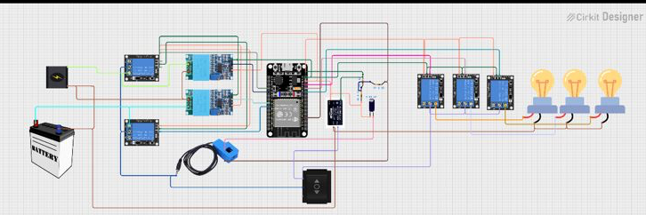
Components Used
🧠
ESP32 NodeMCU
⚡
ACS712 (5A)
Wi-Fi Microcontroller
Current Sensor
🔌
Voltage Sensor
🔧
5V Relay Module
AC Voltage Divider
Appliance Control
📺
0.96" OLED
🔋
AC-05-03 PSU
Local I2C Display
5V DC Power Supply
☁️
Firebase
🌐
HTML/JS
Fig. 2: Circuit Diagram (ESP32 + Sensors + Relay — Cirkit Designer)
Cloud Backend
Web Dashboard

Slide 5
Implementation
01
Sensor Interfacing
02
Power Calculation
03
ESP32 Web Server
ACS712 reads AC current via ESP32 ADC. Voltage sensor uses resistive divider network. Analog readings converted to digital via 12-bit ADC.
V = ADC × (Vref/4096) × scale
I = ADC × sensitivity
P = V × I (Watts)
Energy = P × t (kWh)
ESP32 hosts an HTML/JS webpage. Accessible by opening the ESP32's IP address in any browser on the same Wi-Fi network.
04
Firebase Integration
05
Relay Control
06
OLED Display
ESP32 pushes real-time V, I, P values to Firebase Realtime Database. Timestamps stored for historical analysis and billing.
Web dashboard button writes ON/OFF flag to Firebase. ESP32 reads it and toggles relay output to control load remotely.
0.96" SSD1306 OLED shows live readings locally. Updated every second over I2C. Useful when Wi-Fi is unavailable.

Slide 6
Dashboard & Data Visualization
⚡
Live Monitoring
Real-time V, I, P values displayed on ESP32-hosted web page, updated every second.
📊
Power vs Time
Smooth line chart showing power trend over hours. Plotted using Chart.js or Google Charts.
📅
Daily Usage Stats
Bar chart showing per-day kWh consumed — data pulled from Firebase Realtime Database.
Auto Data Refresh
Fig. 3: Sample Power vs Time Graph (Live Dashboard)
🔁
Dashboard uses JavaScript fetch() to auto-refresh readings every 5 seconds. No page reload needed.

Slide 7
Smart Alerts & Usage Prediction
Step 9: Smart Alerts
Step 10: Usage Prediction
Threshold Logic:
if (power > limit) trigger alert
Alert Channels:
• Email via SMTP / IFTTT
• Telegram Bot API push message
• On-screen red warning banner
Benefit: Prevents overload, saves bill
Data Collection (7-10 days):
Store timestamped power values in Firebase
Prediction Method:
• Simple linear extrapolation formula
• Or basic ML regression model
Output:
Estimated monthly kWh & bill in (Rs)
🧪 Step 11: Testing & Calibration
• Check sensor accuracy against calibrated reference meter • Adjust ADC calibration constants • Ensure stable readings over 10–15 minutes • Validate Firebase data sync and relay switching speed

Slide 8
Results & Conclusion
⚡
📱
☁️
Real-time
Electricity Monitoring
Remote Appliance
Control via Web
Cloud Data Storage
(Firebase)
📊
🔔
🤖
Interactive
Graphs & Charts
Smart Alerts via
Telegram / Email
Monthly Bill
Prediction (ML/Avg)
Conclusion
The Smart Energy Monitoring System successfully integrates ESP32 with Firebase and web technologies to deliver a cost-effective, scalable IoT solution. It provides real-time insights, remote appliance control, smart notifications, and predictive analytics — empowering users to manage energy intelligently.

